Slide 1
World's Best Palindrome Checker
By The legendary Guy Giffone and Andrew Rose

Slide 2
Part 1
https://github.com/GaetanoGiffone/GaetanoGiffone.git
https://github.com/AndrewRose4/Palindrome_Checker.git
(By Gaetano and Andrew)

Slide 3
Part 2
Best case scenario – The word is even or the first and last don’t match.
Worst case scenarios – The word is a palindrome.
Prompt user – O(c) constant
User enters prompt – O(c) constant
Algo checks if the string is odd or even – O(c) constant
Algo goes through the string two characters at a time until it reaches the middle or is mismatched – O(n) n
Display result – O(c) constant
F(n) = Pu(c) + Up(c) + OE(c) + As(n) + Dr(c)
F(n) = O(n)

Slide 4
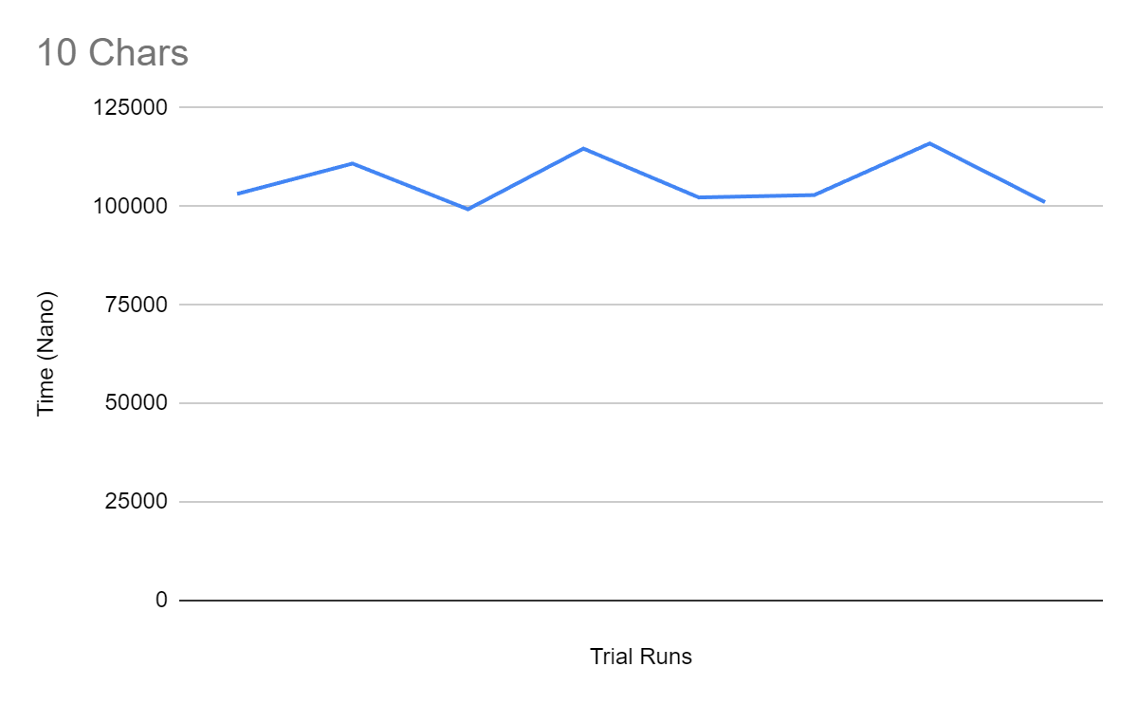
Part 3
Chars | 10 | 100 | 1000 | 10000
Time(Nano Secs) | 103200 | 133800 | 176200 | 810800
 | 110900 | 112700 | 159700 | 681900
 | 99300 | 108100 | 159100 | 1065700
 | 114700 | 109900 | 243100 | 670700
 | 102300 | 112300 | 158500 | 665500
 | 102900 | 107300 | 226100 | 765600
 | 116000 | 121900 | 159600 | 673700
 | 101100 | 105000 | 160300 | 684300
AVG | 106300 | 113875 | 180325 | 752275

Slide 5
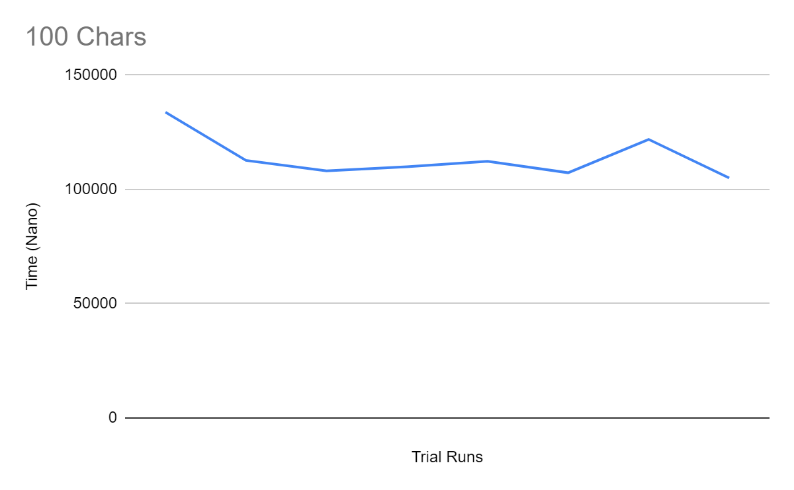
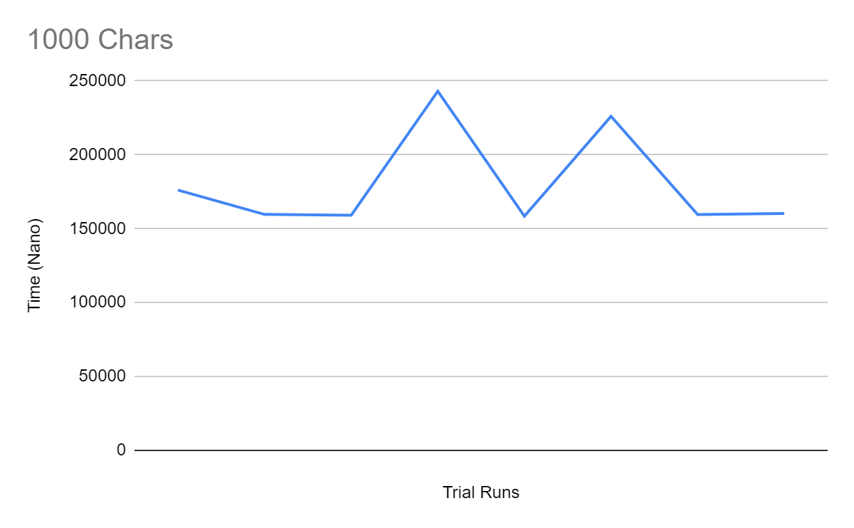
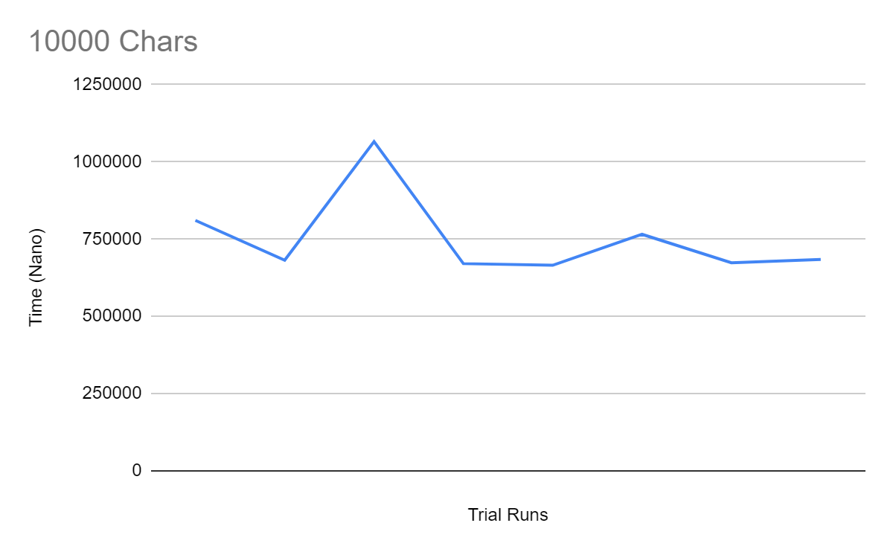
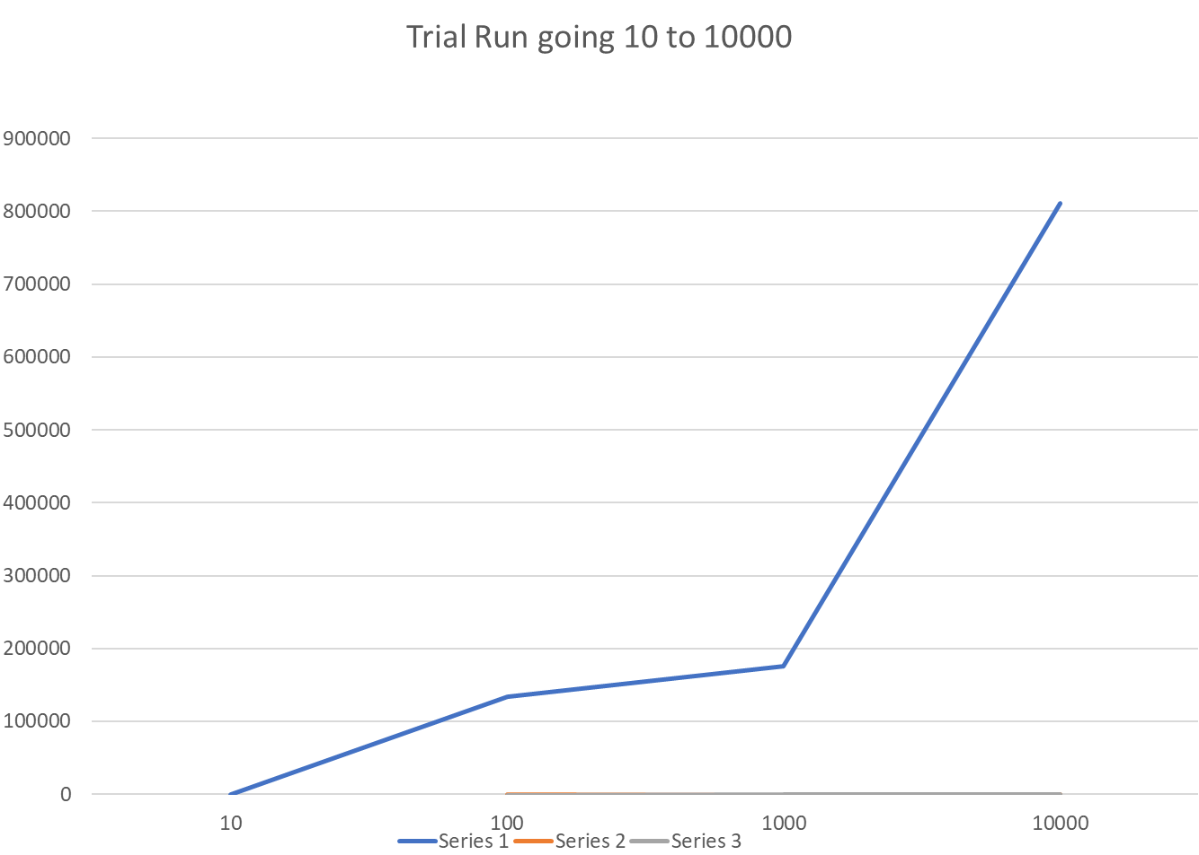
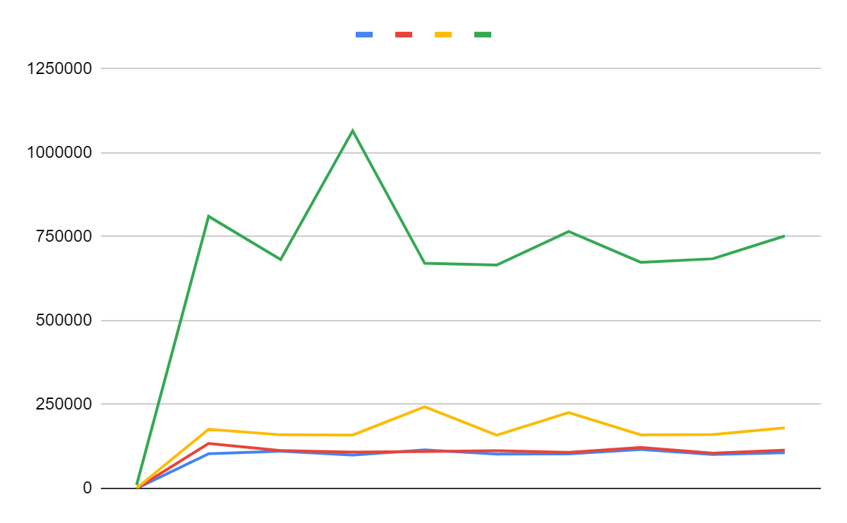
Part 3 - Graphs

Slide 6
Part 3 - Analysis
In the 10 and 100 tests there was very little in the way of deviation but when going to the higher sizes the deviation continued to increase. The final result when comparing how going from 10 to 10,000 shows very small linear increases with a much larger linear increase when jumping from 1000 to 10,000. This matches up with the big O notation of O(n) as there were many constants but overall the algorithm was in terms of n.

Slide 7
Part 4
Before the experiment the pseudo code written predicted that the algorithm would be linear based on n with some constants. This was then proven by creating an algorithm in Java that can sort palindromes. multiple tests of different string size were ran and their time in nanoseconds was recorded. The graph shows a linear increase as the size of the string size changes. The prediction of a linear increase turned out to be correct since as the string size increased there was a linear increase in time required to complete the algorithm.

